Slide 1

Correlations

Slide 2
What are correlations?
a statistical term describing the degree to which two variables move in coordination with one another
correlation coefficients are used to measure the strength of the linear relationship between two variables
Pearson correlation is used to measure the linear relationship between two variables

Slide 3
For example
day | difficulty | efficiency | covered material
1 | 1 | 100 | 0.5
2 | 1 | 100 | 0.5
3 | 2 | 97 | 1
4 | 2 | 96 | 1
5 | 3 | 89 | 2
6 | 3 | 87 | 3
7 | 3 | 88 | 3
8 | 1 | 98 | 1
9 | 4 | 78 | 4
10 | 5 | 75 | 5
Let’s say that there’s a 10 day course on programming and tasks’ difficulty varies from 1 to 5.
Students’ efficiency/average grades is also measured out of 100%.
Covered material is measured in the number of pages covered

Slide 4
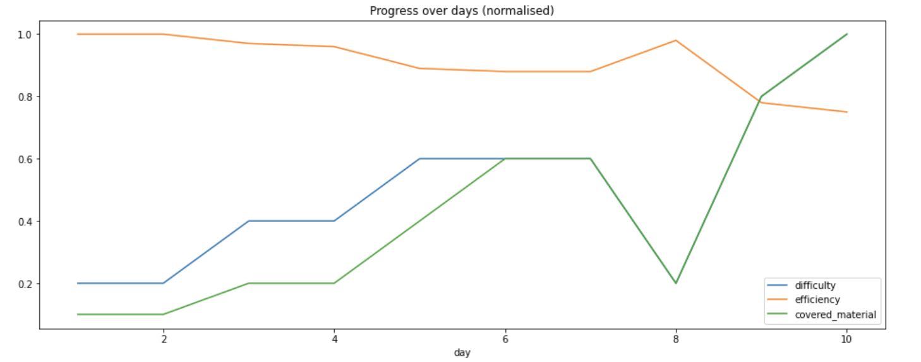
Let’s see how it looks like
What are your observations?
Do you see any correlations?
day | diff | eff | covered material
1 | 1 | 100 | 0.5
2 | 1 | 100 | 0.5
3 | 2 | 97 | 1
4 | 2 | 96 | 1
5 | 3 | 89 | 2
6 | 3 | 87 | 3
7 | 3 | 88 | 3
8 | 1 | 98 | 1
9 | 4 | 78 | 4
10 | 5 | 75 | 5

Slide 5
Let’s see how it looks like
As diffculty goes up, the covered material increases
As difficulty goes up, the efficiency decreases
As covered material increases, the efficiency decreases
day | diff | eff | covered material
1 | 1 | 100 | 0.5
2 | 1 | 100 | 0.5
3 | 2 | 97 | 1
4 | 2 | 96 | 1
5 | 3 | 89 | 2
6 | 3 | 87 | 3
7 | 3 | 88 | 3
8 | 1 | 98 | 1
9 | 4 | 78 | 4
10 | 5 | 75 | 5

Slide 6
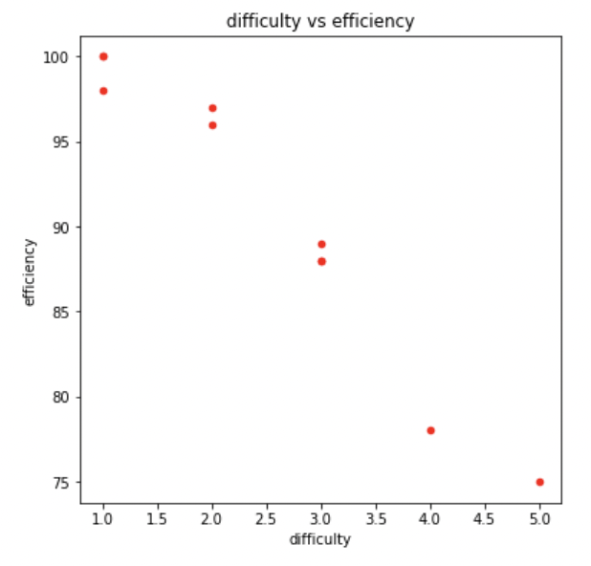
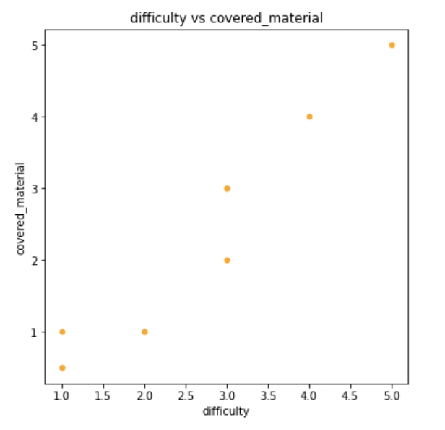
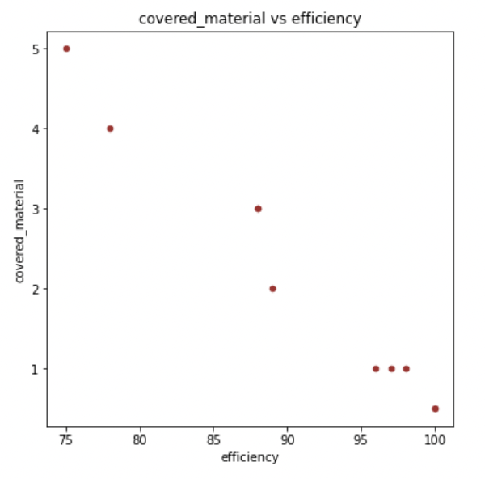
Now, what if we plot only 2 features and compare them?

Slide 7
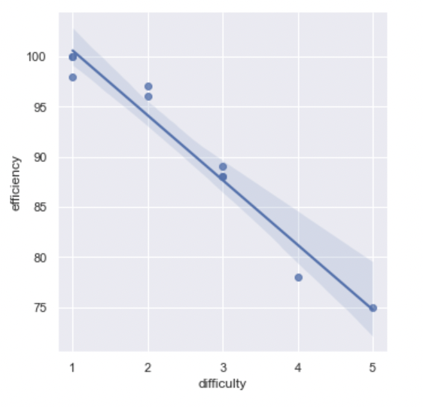
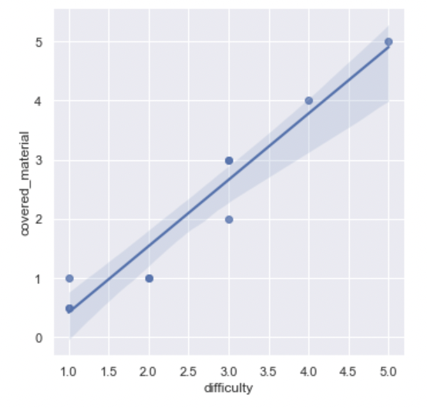
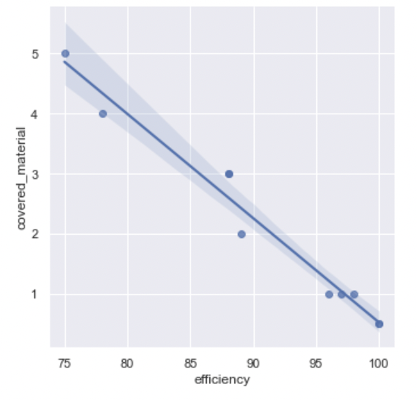
What if we try to predict the directions of the line?

Slide 8
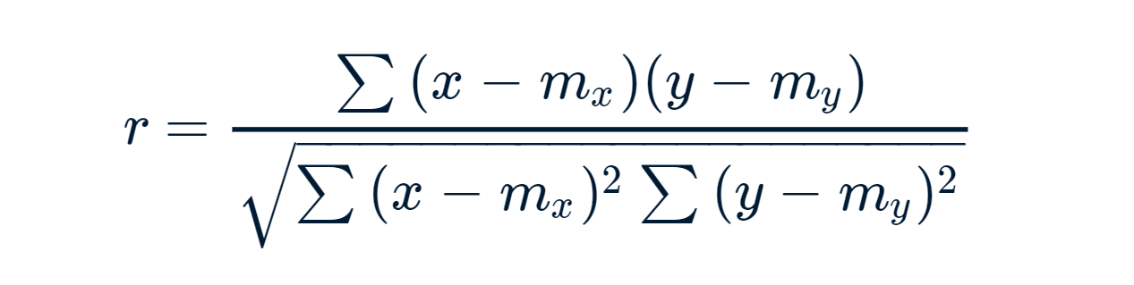
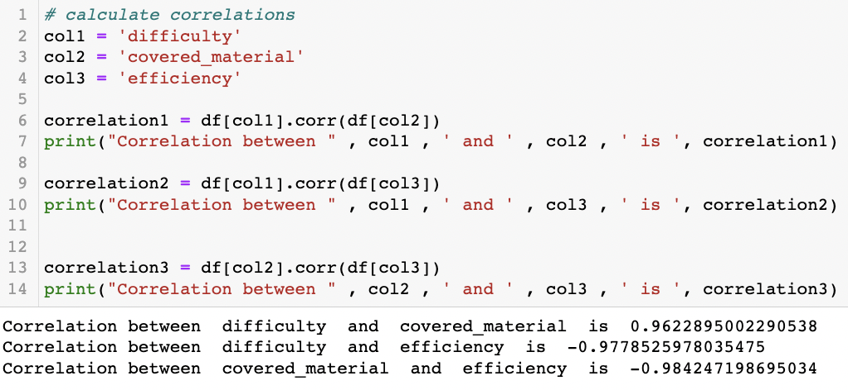

OK, we see that they are correlated. What’s next?
To measure how well correlated the features are, we will calulate the Pearson correlation!
r = Pearson correlation coefficient
x and y = variable values (e.g., 'difficulty', 'efficiency’ values)
m_{x} and m_{y} are means for each variable

Slide 9
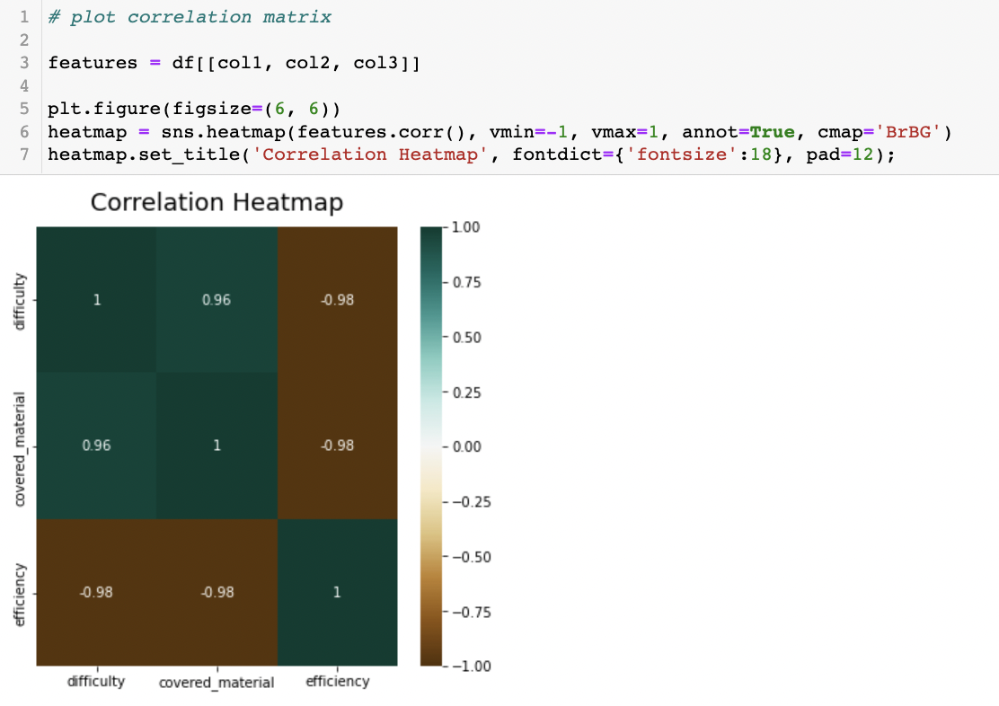
But even better is visualize!
The values we’ve calculated from before, now are on the heatmap
Note that the correlation between same variables are always equal to 1

Slide 10
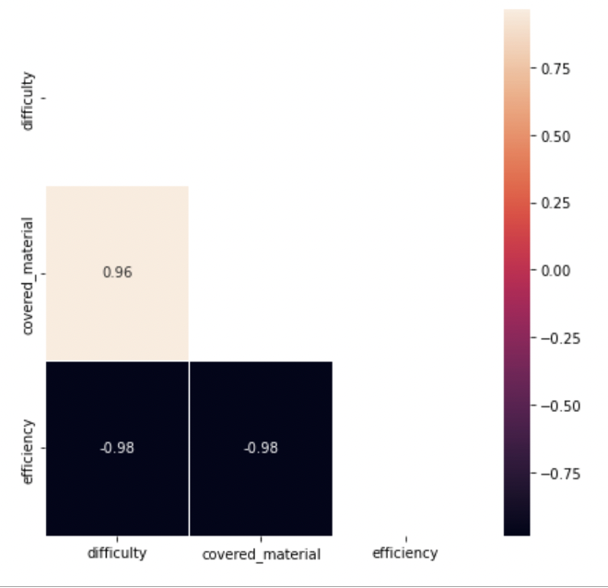
But triangular heatmaps are easier to interprete
The values we’ve calculated from before, now are on the heatmap
Note that the correlation between same variables are always equal to 1
Note that there are repetitions of the same correlation values (0.96 and 0.96)
Triangular heatmap leaves us with only necessary values

Slide 11
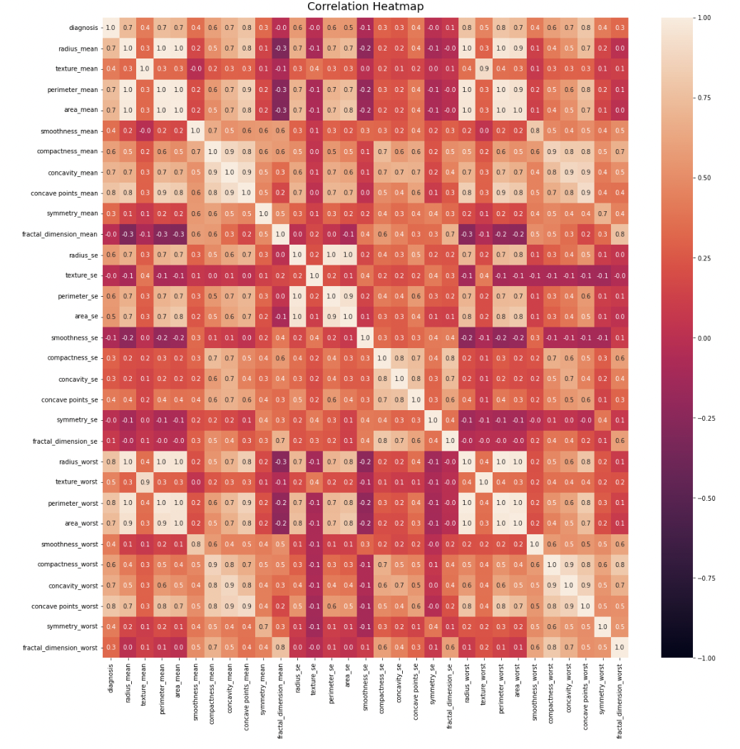
Now, let’s have a look at our project heatmap!

Slide 12
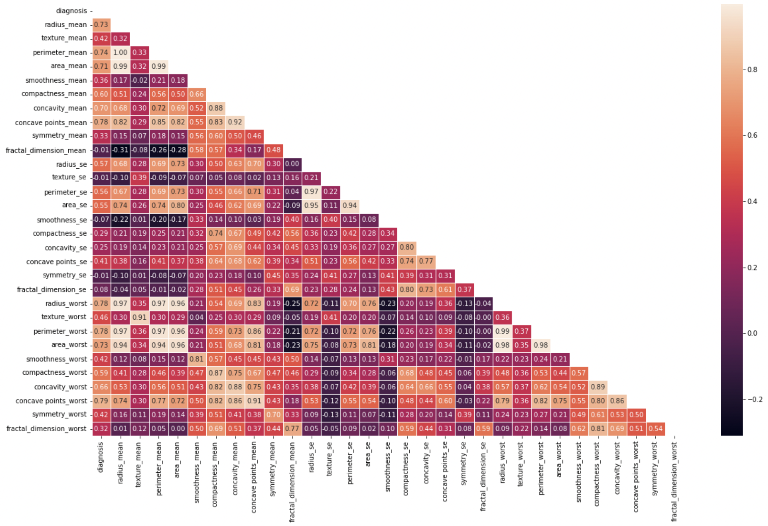
Now, let’s have a look at our project heatmap!
Do you see highly correlated features?
Name at least two features with more than 90% of correlation

Slide 13
Why do even we care about correlations?
In general, it is recommended to avoid having correlated features in your dataset.
Indeed, a group of highly correlated features will not bring additional information (or just very few), but will increase the complexity of the algorithm, thus increasing the risk of errors.
(Depending on the features and the model, correlated features might not always harm the performance of the model but that is a real risk)

Slide 14
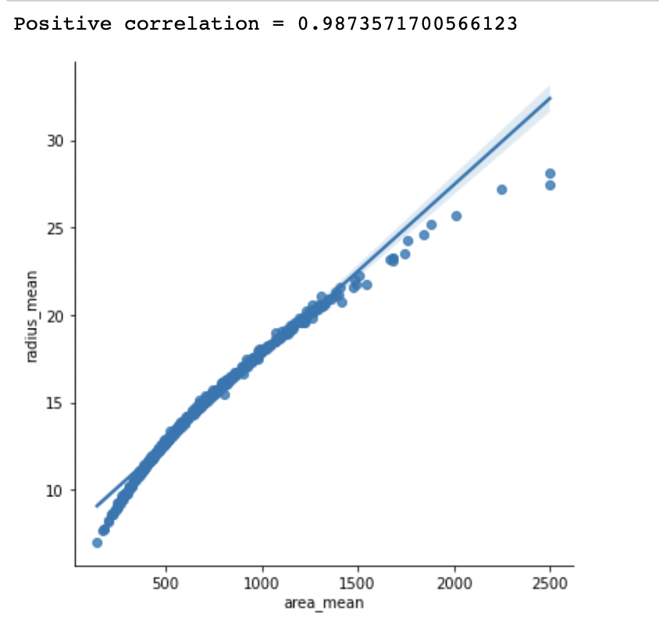
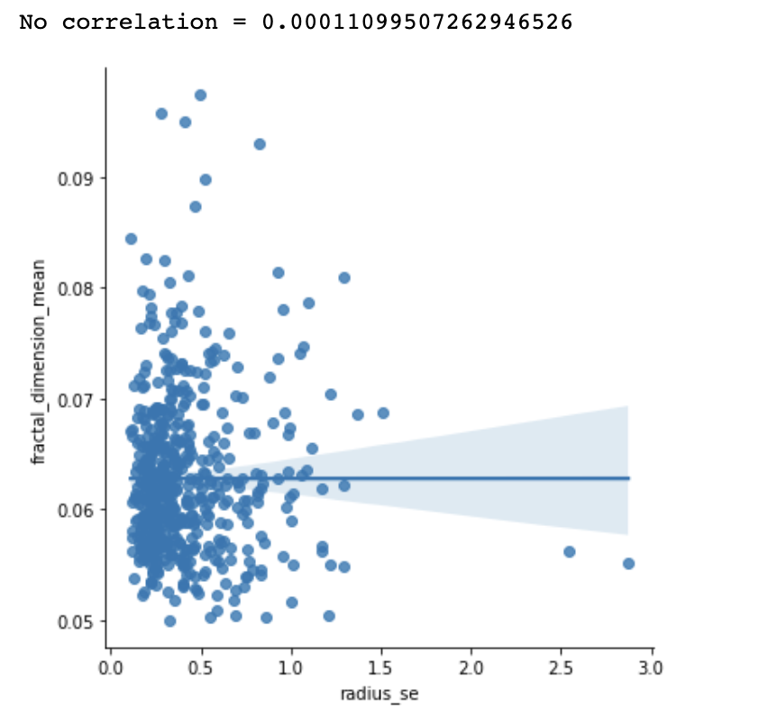
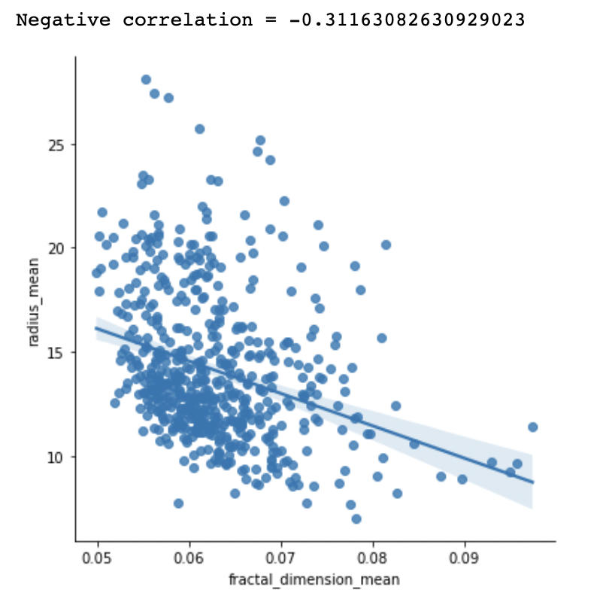
Also, there are 3 types of correlations: positive, negative, and no correlation

Slide 15
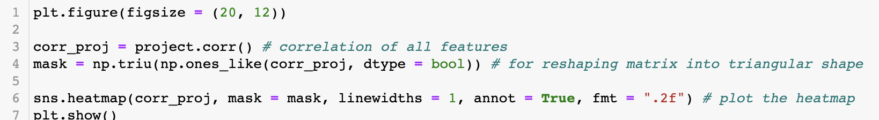
Code syntax:
Line 6 in details:
corr_proj = dataframe (table of correlations)
mask = array of True/False values for correlations (True if we don’t want to display it, False if we want to display it)
linewidths = width of the lines that will divide each cell
annot = if True, write the data value in each cell
fmt = string formatting code to use when adding annotations

Slide 16
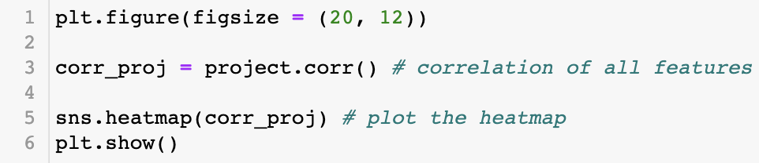
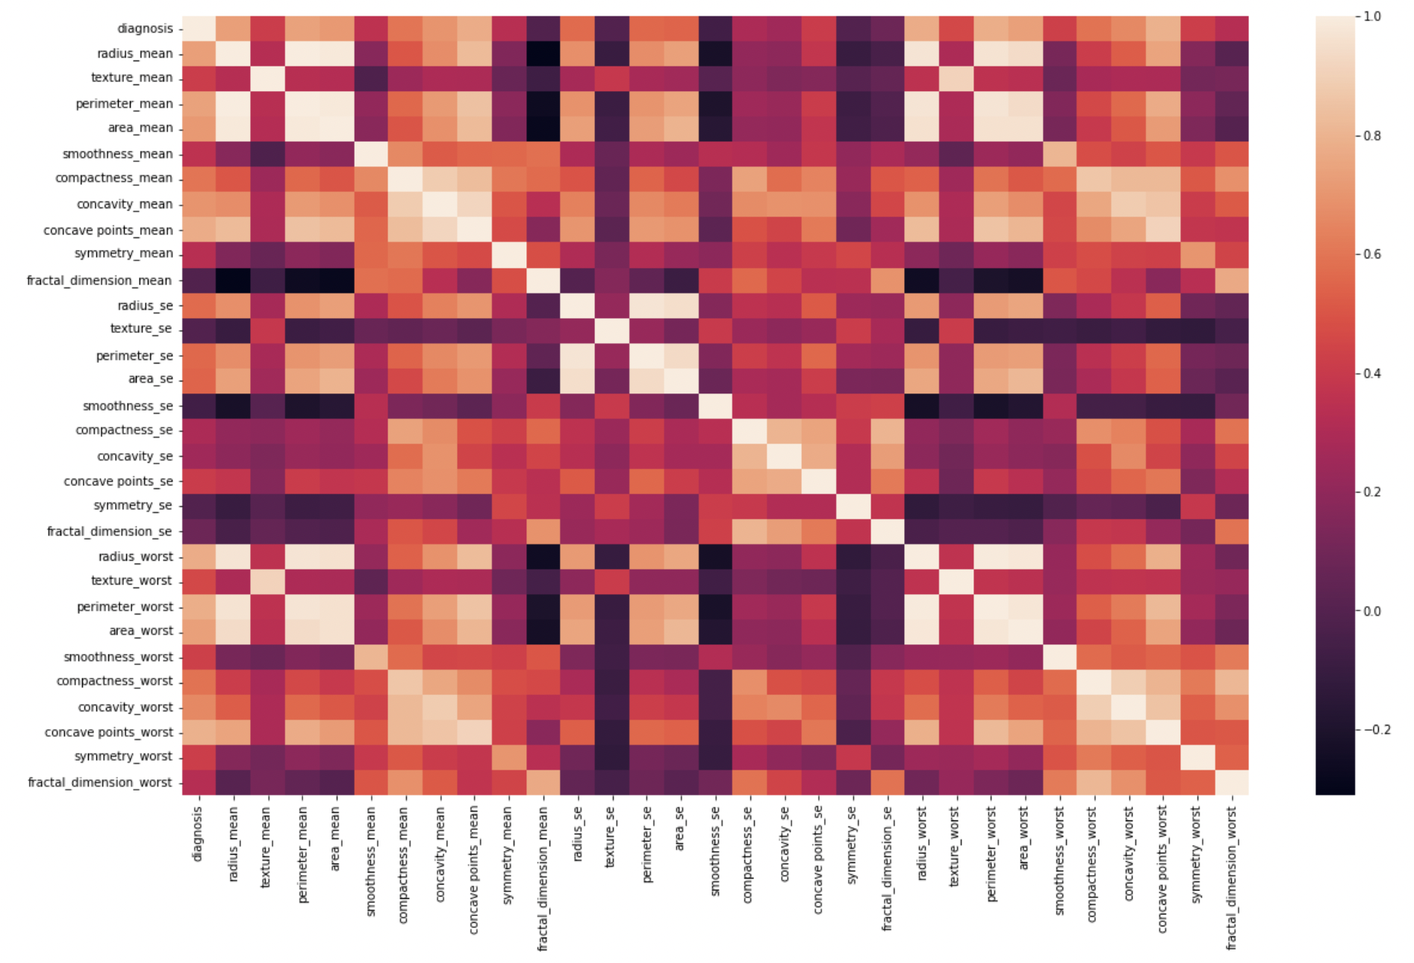
We went from this

Slide 17
To this

Slide 18
Scaling

Slide 19
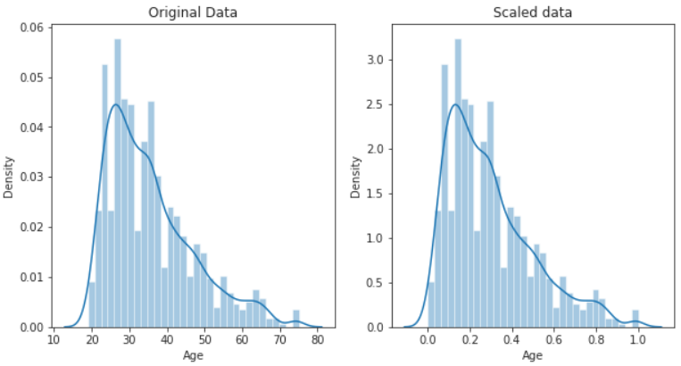
What is scaling and why do we need it?
Scaling means that you're transforming your data so that it fits within a specific scale, like 0-100 or 0-1
Many machine learning algorithms perform better when numerical input variables are scaled to a standard range.

Slide 20
More reasons to do scaling
Input variables may have different units (e.g. feet, kilometers, and hours) that, in turn, may mean the variables have different scales.
Differences in the scales across input variables may increase the difficulty of the problem being modeled.
For example, if our input variables are given in thousands of units, the model will learn large weight values, which increases the risk of larger errors

Slide 21
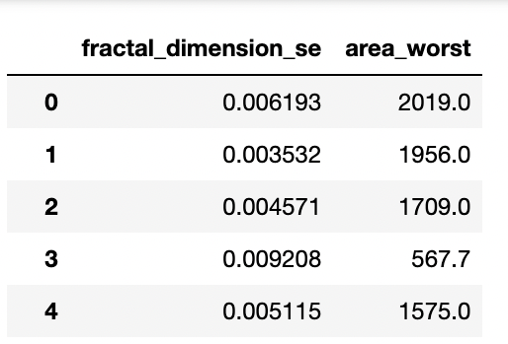
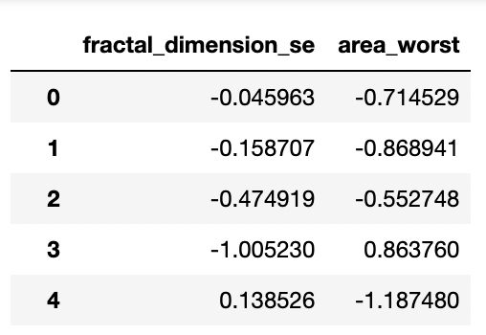
For our project, we want to convert this:
Did you notice how fractal_dimension_se and area_worst differ for 10⁶ units?

Slide 22
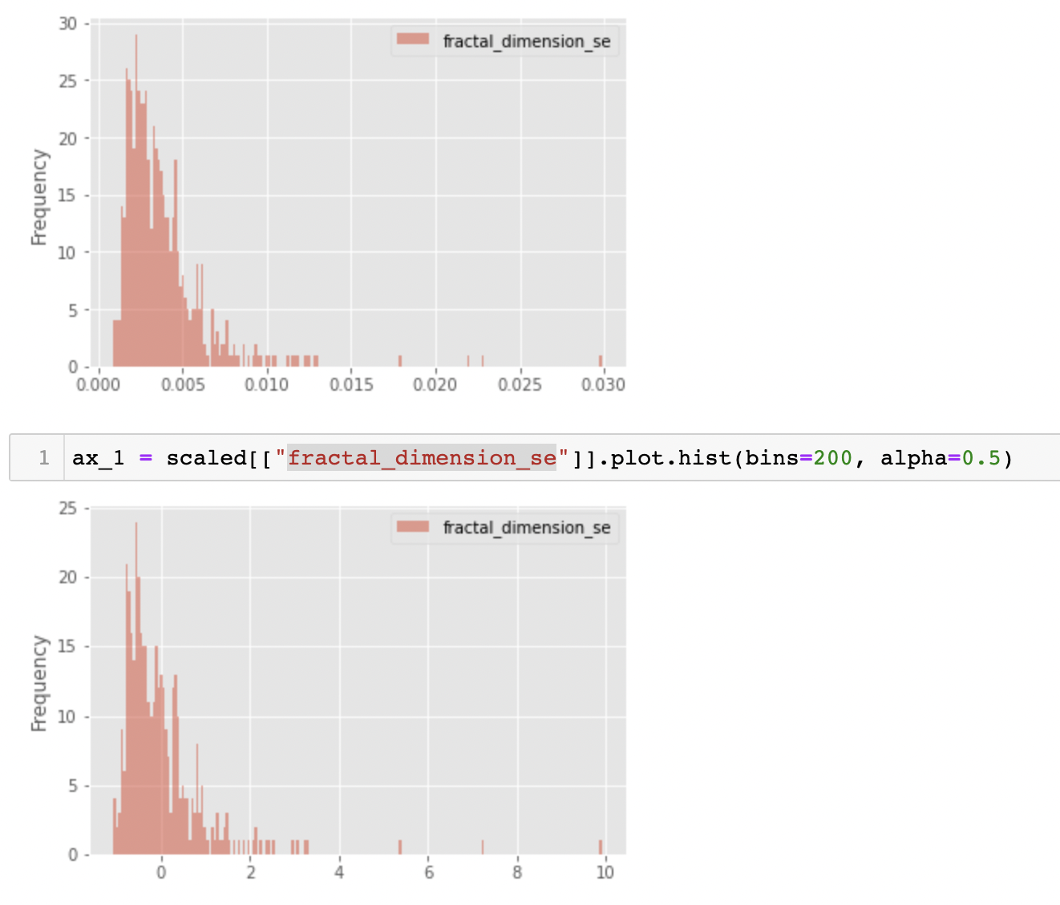
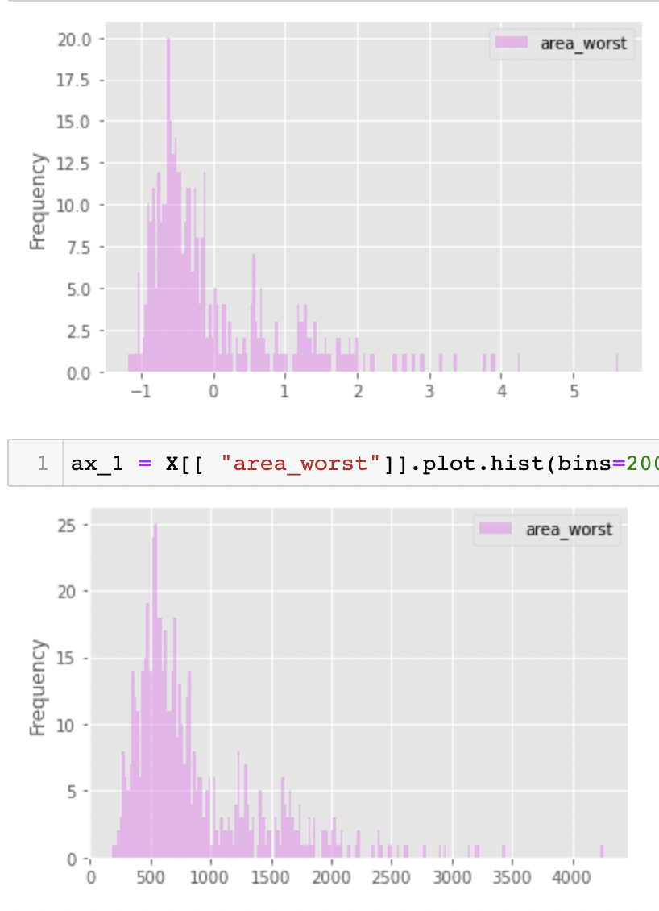
So that our data distribution changes like this:

Slide 23
Reference
Documentation:
https://seaborn.pydata.org/generated/seaborn.heatmap.html
https://numpy.org/doc/stable/reference/generated/numpy.triu.html
Article on scaling:
https://machinelearningmastery.com/standardscaler-and-minmaxscaler-transforms-in-python/
Notes:
Libraries documentation:

